Slide 1
Chapter 12:
Polymorphism, Virtual Functions and Abstract Classes

Slide 2
Objectives
  Learn about Polymorphism
  Learn about virtual functions
  Learn about virtual destructor
  Rules of virtual functions
  Become aware of abstract classes
C++ Programming: From Problem Analysis to Program Design, Seventh Edition

Slide 3
Polymorphism and Virtual Function
Polymorphism principle refers to that objects (derived objects) belonging to different classes are able to respond to the same message but in different forms.
We use a pointer or reference to base class to refer to all the derived objects.
The goal of the polymorphism is generalization
Polymorphism means “many forms”
C++ Programming: From Problem Analysis to Program Design, Seventh Edition

Slide 4
Polymorphism and Virtual Function [con’t]
Polymorphism Requirements:
  There must be an inheritance hierarchy
  The base class in the hierarchy must have a virtual method with the same signature to its corresponding method in the derived class
  There must be either a pointer or a reference to the base class object. This pointer of reference is used t invoke a virtual function.
C++ Programming: From Problem Analysis to Program Design, Seventh Edition

Slide 5
Polymorphism and Virtual Function [con’t]
  A virtual function is like other functions but it declared with reserved word virtual.
When two methods with same function signature in both the base and derived classes the method in the base class is declared as virtual
Compiler determines which virtual functions to use at run time based on the type of object pointed to by base pointer rather than the type of the pointer.
By making the base pointer points to different derived objects we can execute different versions of the virtual function
C++ Programming: From Problem Analysis to Program Design, Seventh Edition

Slide 6
Polymorphism and Virtual Function [con’t]
Compile-time binding: the necessary code to call specific function is generated by compiler
  Also known as static binding or early binding
Virtual function: binding occurs at program execution time, not at compile time
C++ Programming: From Problem Analysis to Program Design, Seventh Edition

Slide 7
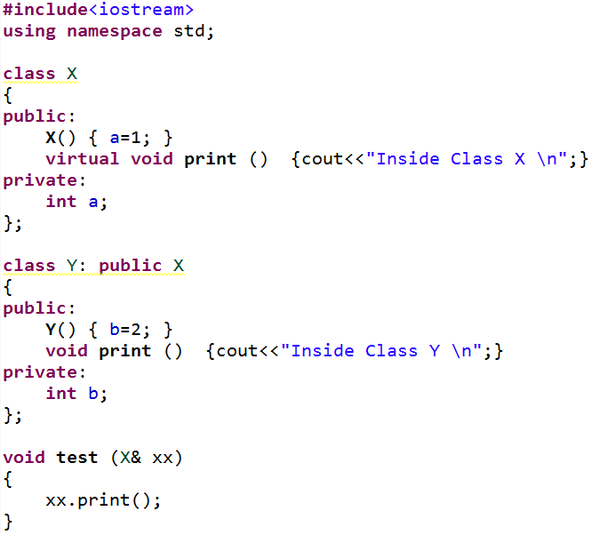
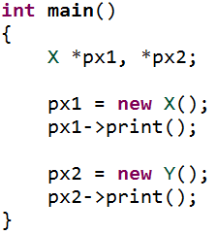
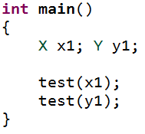

Polymorphism and Virtual Function [con’t]
OUTPUT
OUTPUT
C++ Programming: From Problem Analysis to Program Design, Seventh Edition

Slide 8
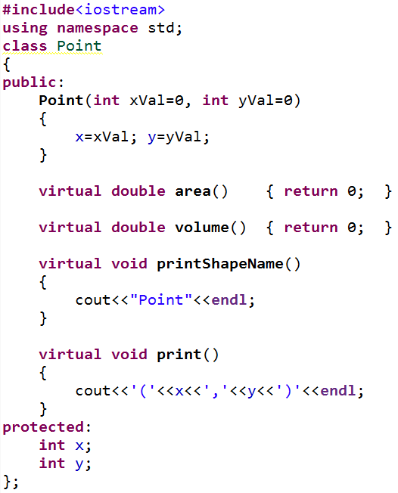
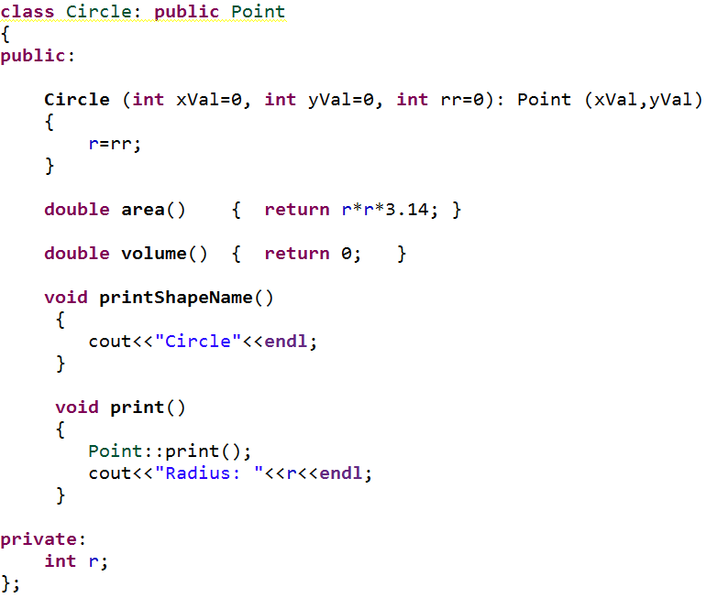
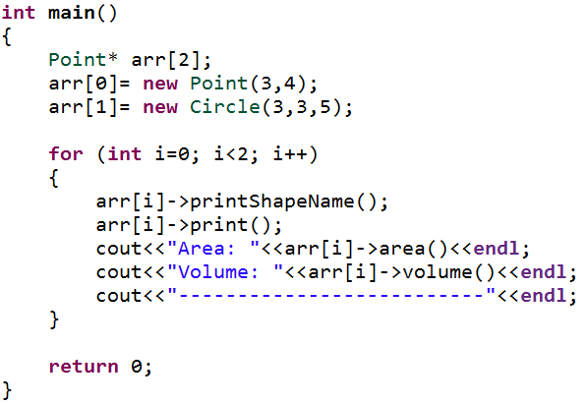
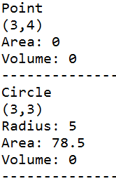
Polymorphism and Virtual Function [con’t]
C++ Programming: From Problem Analysis to Program Design, Seventh Edition

Slide 9
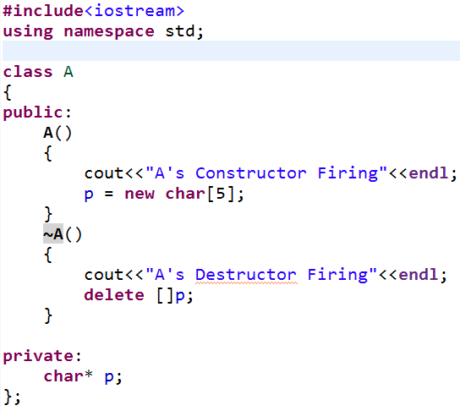
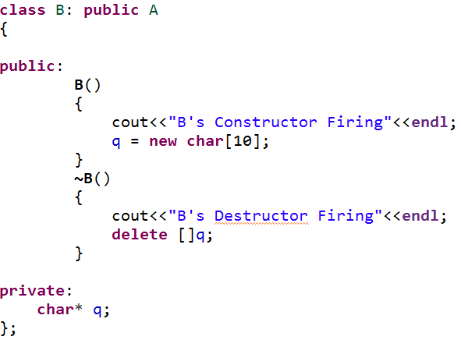
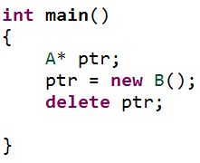

Virtual Destructors
ptr
q
B
p
A
OUTPUT
B’s Destructor was not called
C++ Programming: From Problem Analysis to Program Design, Seventh Edition

Slide 10
Virtual Destructors
The call new operator cause the constructor A() and B() to fire
When we invoke delete operator on ptr only ~A() fire despite the fact that ptr points to B object because the destructor are not virtual
The compiler uses ptr’s data type to (i.e., A*) to determine which destruct to call thus only ~A() is called.
The problem with previous program can be fixed by making the base destructor virtual
C++ Programming: From Problem Analysis to Program Design, Seventh Edition

Slide 11
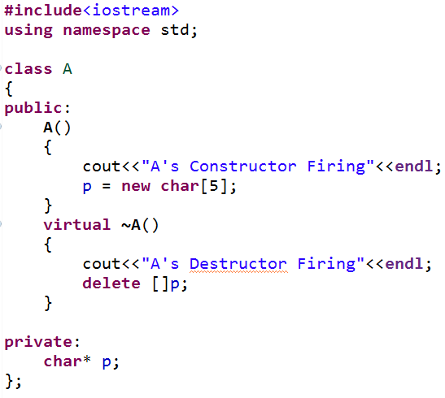
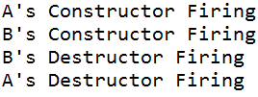
Virtual Destructors [con’t]
OUTPUT
C++ Programming: From Problem Analysis to Program Design, Seventh Edition

Slide 12
Virtual Destructors [con’t]
Virtual destructor of a base class automatically makes the destructor of a derived class virtual
  After executing the destructor of the derived class, the destructor of the base class executes
If a base class contains virtual functions, make the destructor of the base class virtual
C++ Programming: From Problem Analysis to Program Design, Seventh Edition

Slide 13
Rules of Virtual Functions
The virtual functions must be members of some class
They can not be static
The prototypes of the base version of a virtual function an all the derived class versions must be identical
We can not have virtual constructors but we can have virtual destructors
C++ Programming: From Problem Analysis to Program Design, Seventh Edition

Slide 14
Abstract Classes and Pure Virtual Functions
New classes can be derived through inheritance without designing them from scratch
  Derived classes inherit existing members of base class
  Can add their own members
  Can redefine or override public and protected member functions
Base class can contain functions that you would want each derived class to implement
  However, base class may contain functions that may not have meaningful definitions in the base class
C++ Programming: From Problem Analysis to Program Design, Seventh Edition

Slide 15
Abstract Classes and Pure Virtual Functions (cont’d.)
Pure virtual functions:
  Do not have definitions (bodies have no code)
Example: virtual void draw() = 0;
Abstract class: a class with one or more virtual functions
  Can contain instance variables, constructors, and functions that are not pure virtual
  Class must provide the definitions of constructor/functions that are not pure virtual
C++ Programming: From Problem Analysis to Program Design, Seventh Edition

Slide 16
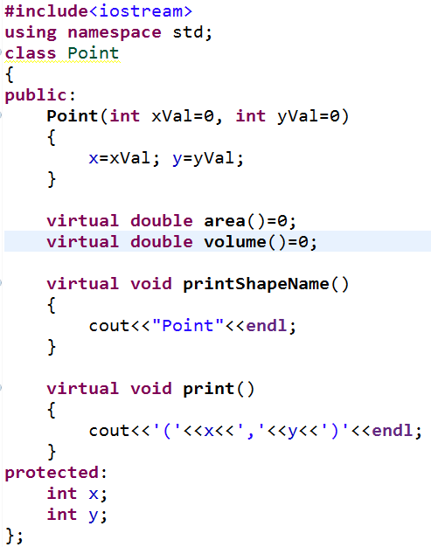
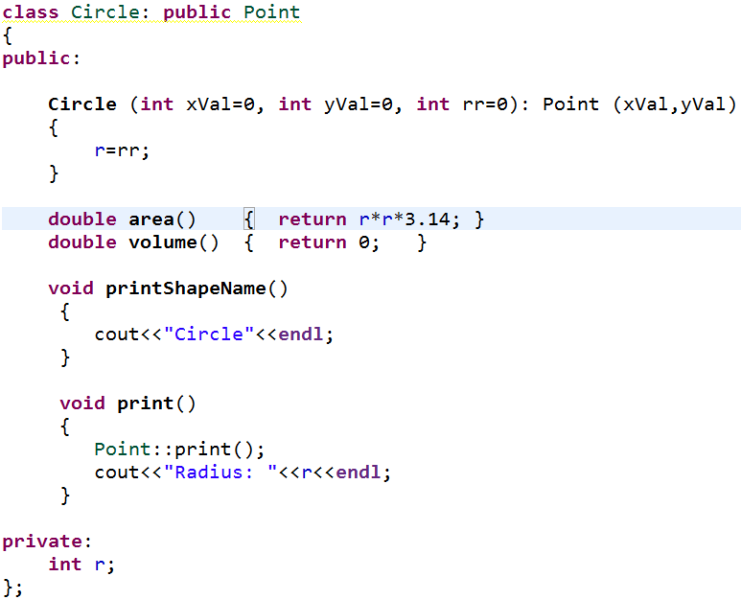
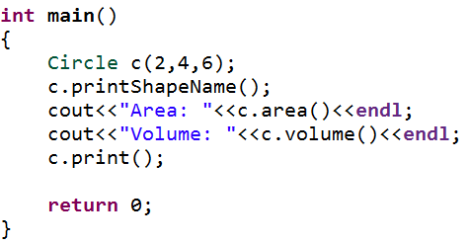
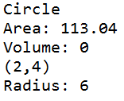
Abstract Classes and Pure Virtual Functions
OUTPUT
C++ Programming: From Problem Analysis to Program Design, Seventh Edition

Slide 17
Abstract Classes and Pure Virtual Functions
you cannot create objects from the abstract class
C++ Programming: From Problem Analysis to Program Design, Seventh Edition

Slide 18
Summary (cont’d.)
Dynamic variable: created during execution
  Created using new, deallocated using delete
Shallow copy: two or more pointers of the same type point to the same memory
Deep copy: two or more pointers of the same type have their own copies of the data
Binding of virtual functions occurs at execution time (dynamic or run-time binding)
C++ Programming: From Problem Analysis to Program Design, Seventh Edition

Slide 19
The End
C++ Programming: From Problem Analysis to Program Design, Seventh Edition

